Slide 1

2nd IEEE International Challenge in Design Methods for Power Electronics 2025 IEEE Power Electronics Society MagNet Challenge 2 “From Steady-State to Transient Models!”
Kickoff Meeting, February 25, 2025
Shukai Wang, Hyukjae Kwon, Haoran Li, Thomas Guillod,
Minjie Chen, Charles R. Sullivan
GitHub Repository: https://github.com/minjiechen/magnetchallenge-2
pelsmagnet@gmail.com
MagNet 2025 Organizing Team

Slide 2







Prize Pool (targeting 60k)
IEEE Power Electronics Society (35k USD)
Princeton University (Administrative)
Nvidia (High End Nvidia GPUs)
Wurth Electronik (5k USD)
ITG Electronics (5k USD)
Texas Instruments (5k USD, pending)
pSemi (5k USD, pending)
TSMC (5k USD, pending)

Slide 3
Overview
11:30 AM – 1:30 PM ET
MagNet Challenge 2 - Zoom Launch
February 26th Wednesday at 9 AM EST
Zoom registration link: https://princeton.zoom.us/webinar/register/WN_SKNgzuqBRQKqVYwajY6tJA
MagNet Challenge 2 - APEC Launch
March 19th, Wednesday, 2 PM ET
In-person: Atlanta Omni Hotel, Room Grand A
Zoom registration link: https://princeton.zoom.us/webinar/register/WN_vjewaKl4Sry32FcIrbLYiw
MagNetX Database - Presentations at APEC
March 19th, Wednesday, 9:50 AM – 10:40 AM ET
Location: Conference Venue Level Three, A301 [Oral]
“MagNetX: Extending the MagNet Database for Modeling Power Magnetics in Transient”
March 20th, Thursday, 11:30 AM – 1:30 PM ET
Location: Conference Venue Level One, Hall A3 [Poster]
“MagNetX: Foundation Neural Network Models for Simulating Power Magnetics in Transient”

Slide 4
MagNet 2025 – A Transient Challenge
MagNet 2025 Organizing Committee:
Shukai Wang, Princeton, USA
Hyukjae Kwon, Princeton, USA
Haoran Li, Princeton, USA
Minjie Chen, Princeton, USA
Charles Sullivan, Dartmouth, USA
Thomas Guillod, Dartmouth, USA
Judge Committee:
Charles Sullivan, Dartmouth, USA
David Perreault, MIT, USA
Jürgen Biela, ETH Zurich, Switzerland
Dragan Maksimovic, CU Boulder, USA
SY Ron Hui, CUHK, Hongkong
Liaison Committee:
Han Cui, Tianjin, China
Sinan Li, Sydney, Australia
Oliver Wallscheid, Paderborn, Germany
Advisory Committee:
Gerard Hurley, Nat. Univ. of Ireland, Ireland
Maeve Duffy, Nat. Univ. of Ireland, Ireland
Brad Lehman, Northeastern University, USA
Matt Wilkowski, Wurth Electronics, USA
Mike Ranjram, Arizona State University, USA
Alex Hanson, UT Austin, USA
More …

Slide 5
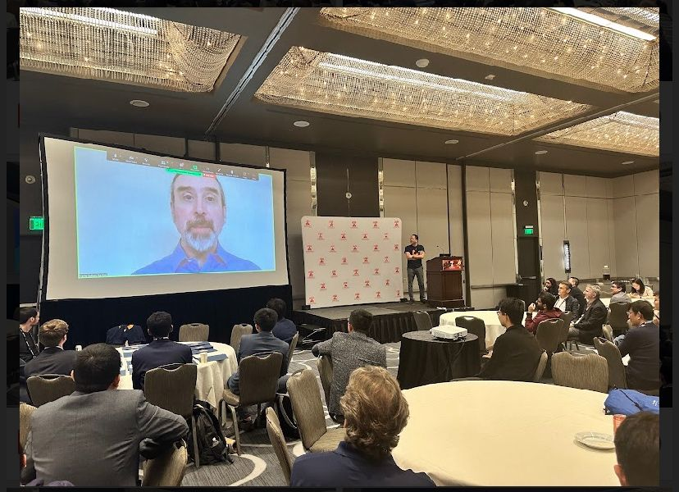
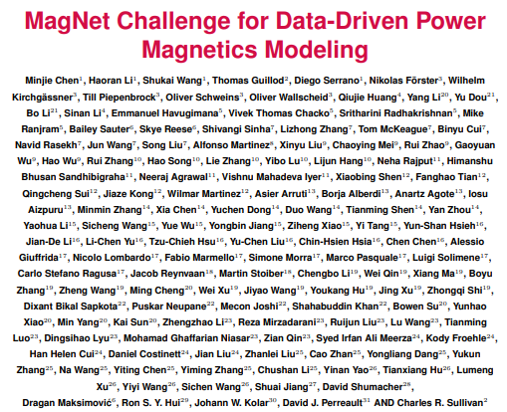
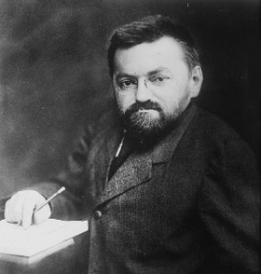
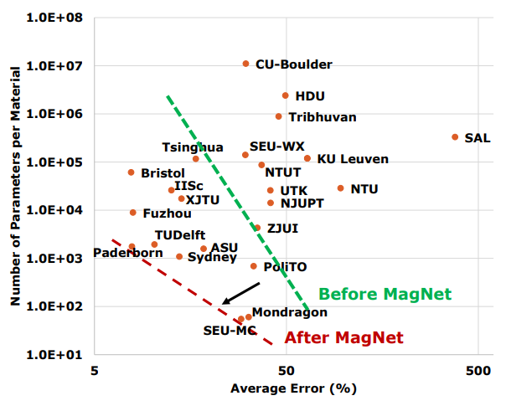
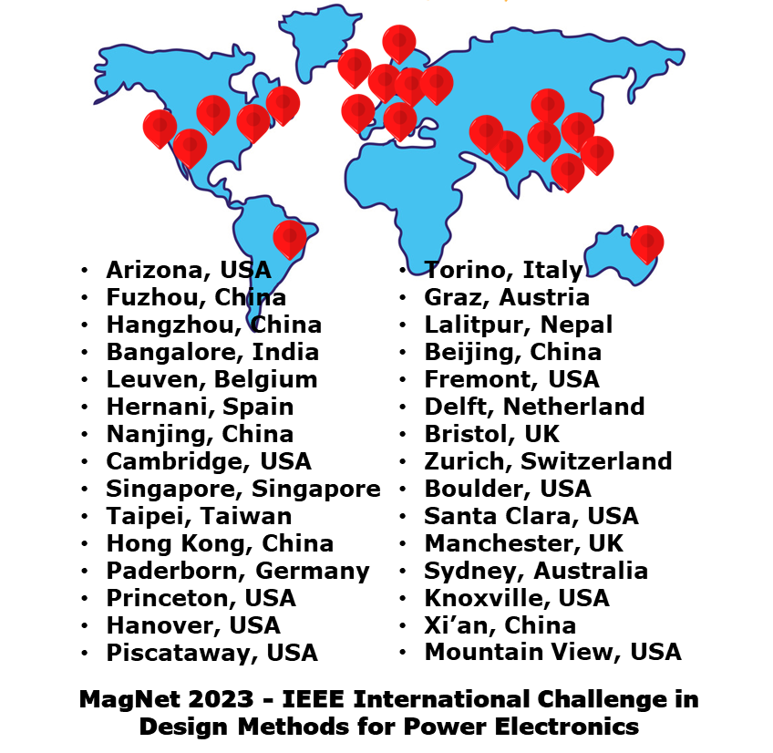
A Very Successful MagNet Challenge 1
133 co-authors
New SOTA
24 teams
Many theses
Charles Steinmetz (1865-1923)

Slide 6

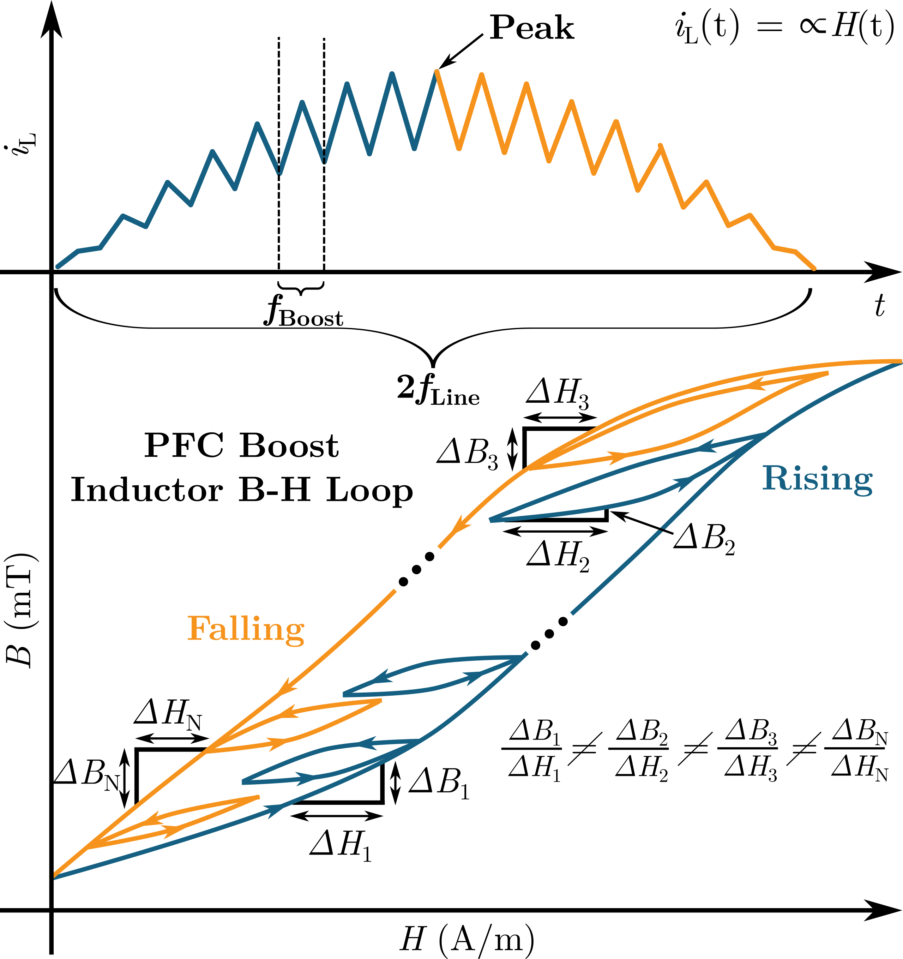
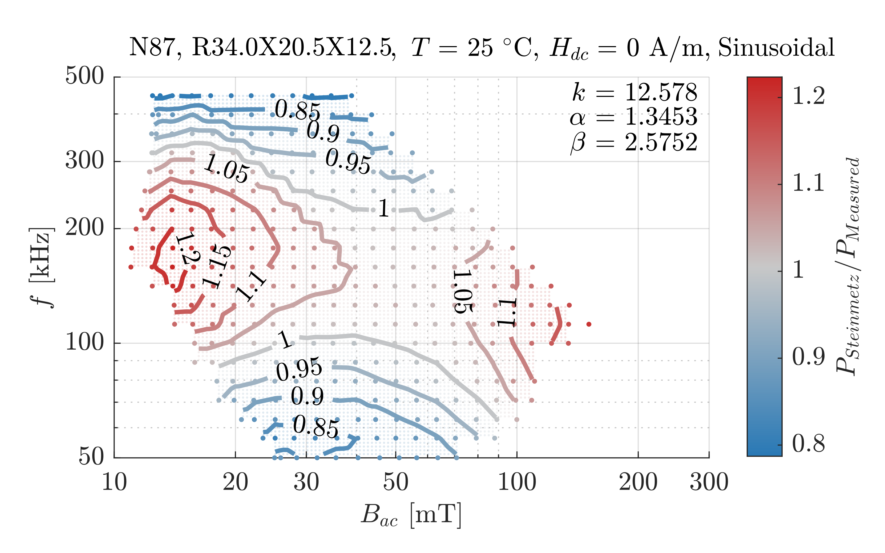
MagNet 2025 – A Transient Challenge
Steinmetz Equation
(1890s)
Preisach Model & J-A Model
(1930s) & (1980s)

Slide 7
Foundation Model for Power Magnetics
Motivation:
MagNet Challenge 1 - find something better than Steinmetz
MagNet Challenge 2 - what’s the best modeling framework
Foundation Model for Magnetic Materials?
Read history and predict future based on new inputs
Frequency agnostic (non-steady-state)
Universal time step (long- or short-time steps)
Hypothesis: impact of initial state has finite time horizon
…
A Rigorous Mathematical Framework?
A compact and efficient, hopefully explainable modeling framework which will converge over time to the material’s steady state condition
Physics-based, data-driven, or hybrid …

Slide 8

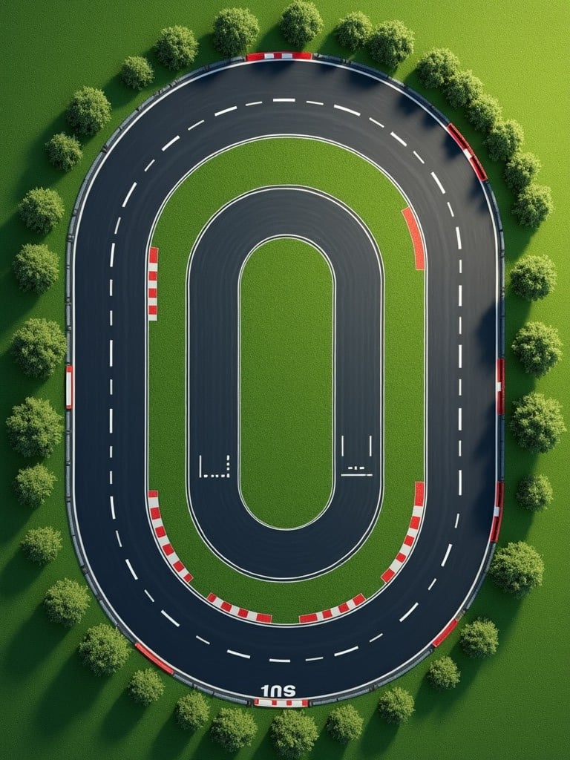
2025: from Racetrack to Open Path
Periodic Steady State Excitations
Non-Periodic Excitations

Slide 9
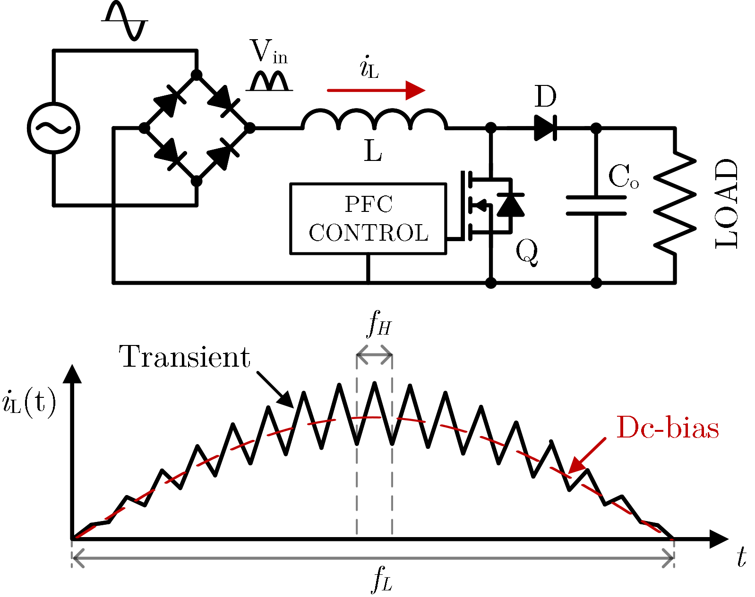
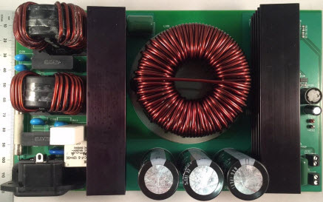
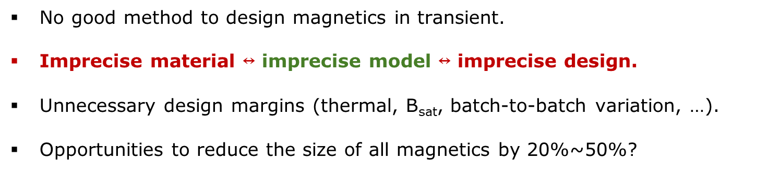
Motivation for the MagNet Challenge 2
No good method to design magnetics in transient.
Imprecise material $↔$ imprecise model $↔$ imprecise design.
Unnecessary design margins (thermal, B_{sat}, batch-to-batch variation, …).
Opportunities to reduce the size of all magnetics by 20%~50%?
An example PFC converter
Make every AC-DC adapters 30% smaller?

Slide 10
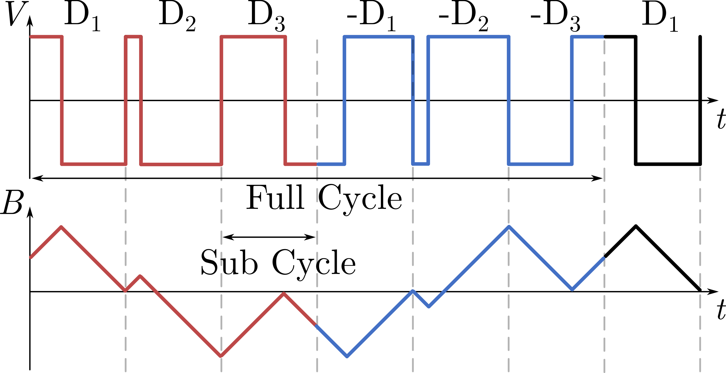
New MagNetX Dataset for Transient Dynamics
15 ferrite materials
>5,000 sequences per material
Fixed sampling frequency: 16 MHz
Duty cycle step changes D = 0.2~0.8, min step size = 0.1
Fixed 7 subcycle frequency f = 50kHz~800kHz
Three temperatures: 25ºC, 50ºC, 70ºC
100 subcycles per sequence
How to collect transient data?
A mix of high frequency transient and low frequency steady state
Applicable to PFC converters, etc.
Example symmetric magnetizing and demagnetizing sequences
Hyukjae Kwon, Shukai Wang, Haoran Li, et al. “MagNetX: Extending the MagNet Database for Modeling Power Magnetics in Transient,” TechRxiv. December 11, 2024. Accepted to APEC 2025.
Notes:
Motivation on what is the challenge of colleceting transient data? We have to collect the data in a very specific way where we are mixing high frequency dynamic transient exciations with low frequency steady state to create a psedo transient waveform. Which is also applicable since PFC behaves similarly.

Slide 11
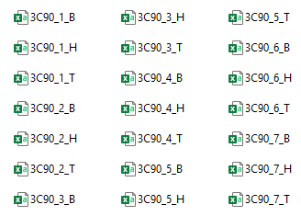
Data Structure
Material Folder: 3C90
For Training
Material format:
7 sets of B(t), H(t), T for each material
Frequency information not provided
Sampling frequency for all sequences: 16MHz
50kHz: 32016 steps
80kHz: 20016 steps
125kHz: 12816 steps
200kHz: 8015 steps
320kHz: 4975 steps
500kHz: 3216 steps
800kHz: 1967 steps
Testing
Same length for all sequences (TBA)
Notes:
Important differences between this and challenge 1 is that this is fixed sampling time step. Model should be freuqncy agnostic so we intentionally not provided the frequency information in the data given to the teams

Slide 12
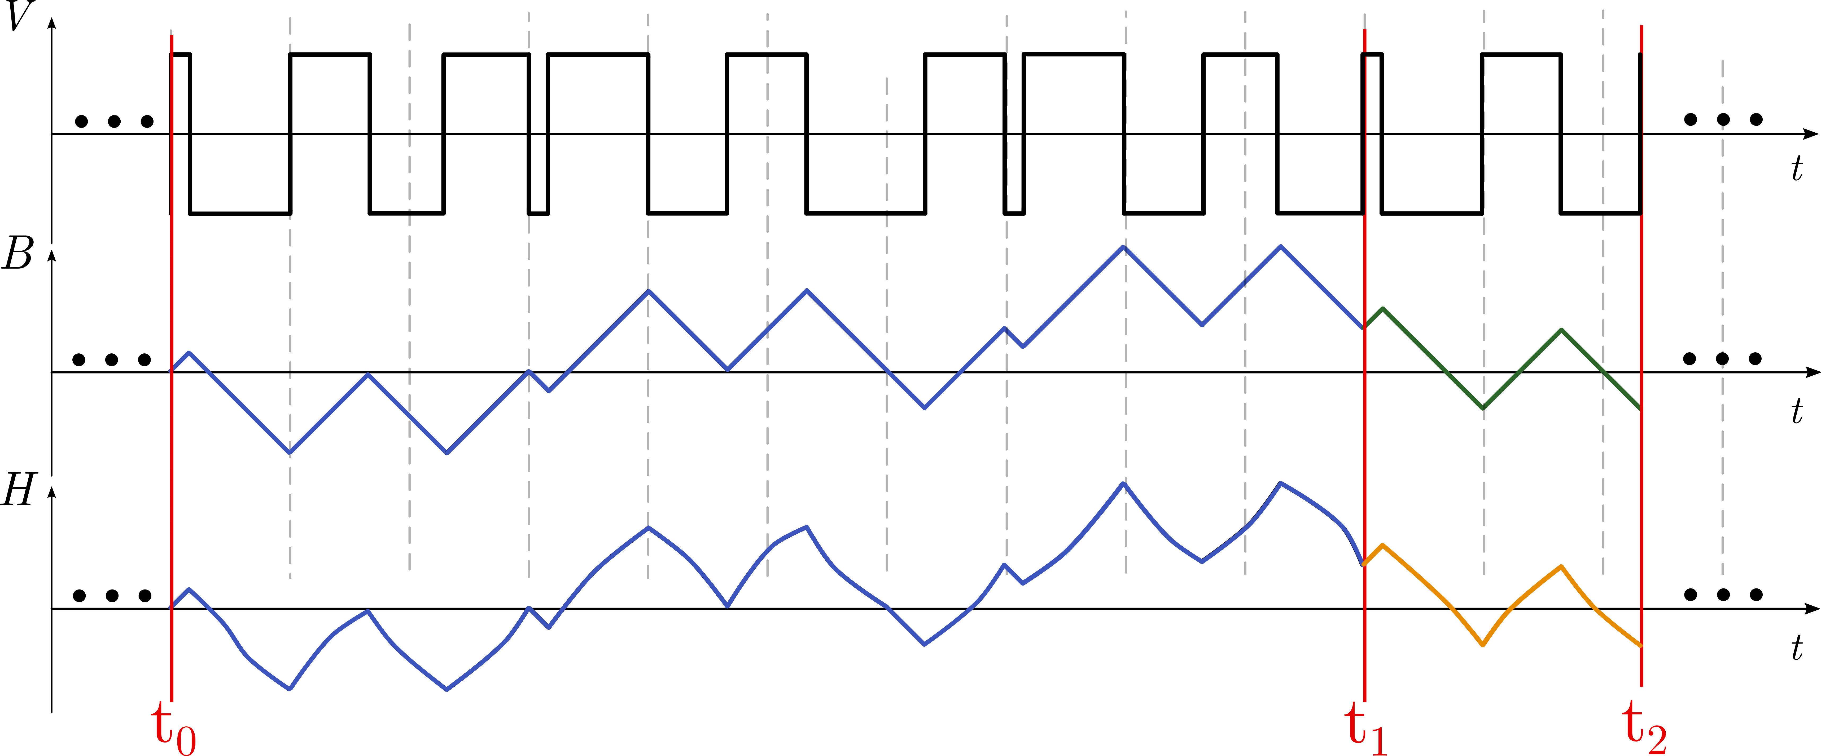
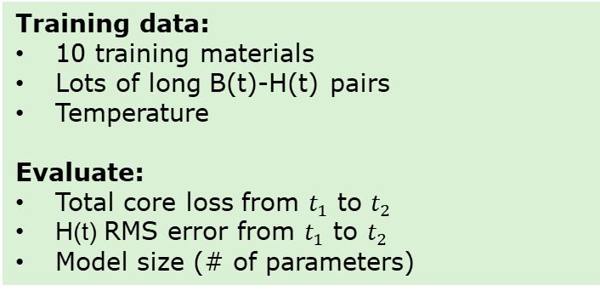
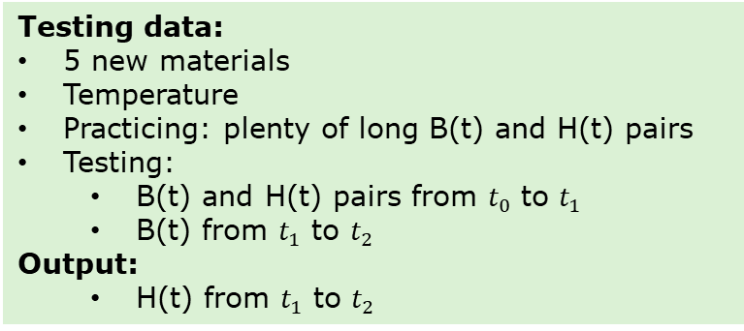
Outcome: A Callable Prediction Function
Training data:
10 training materials
Lots of long B(t)-H(t) pairs
Temperature
Evaluate:
Total core loss from $t_{1}$ to $t_{2}$
H(t) RMS error from $t_{1}$ to $t_{2}$
Model size (# of parameters)
Testing data:
5 new materials
Temperature
Practicing: plenty of long B(t) and H(t) pairs
Testing:
B(t) and H(t) pairs from $t_{0}$ to $t_{1}$
B(t) from $t_{1}$ to $t_{2}$
Output:
H(t) from $t_{1}$ to $t_{2}$
Future
Past
Output
Hyukjae Kwon, Shukai Wang, Haoran Li, et al. “MagNetX: Extending the MagNet Database for Modeling Power Magnetics in Transient,” TechRxiv. December 11, 2024. Accepted to APEC 2025.
Notes:
Can have a short past long future or long past short future, can be variable

Slide 13
Strategies to win the Challenge?
Understand physics and understand data
Model / method should be reasonably explainable
Balancing model generality and model accuracy
Understand materials and understand design
What manufacturers provide? – modeling framework
What designers need? – software engineering
Respect legacy and challenge legacy
Understand what has been done
Challenge existing understanding
Leverage modern methods and tools
Winning team structure:
Data Science
Power Electronics
Software Engineering
Magnetics
Notes:
Encourging teams to focus on more physics based methods, also look at materials, perhaps there are existing methods, and dive more into literature. While magnet challenge 1 is more constraint, but 2 is more open, hope teams will diversify into more broad areas and more outcomes

Slide 14
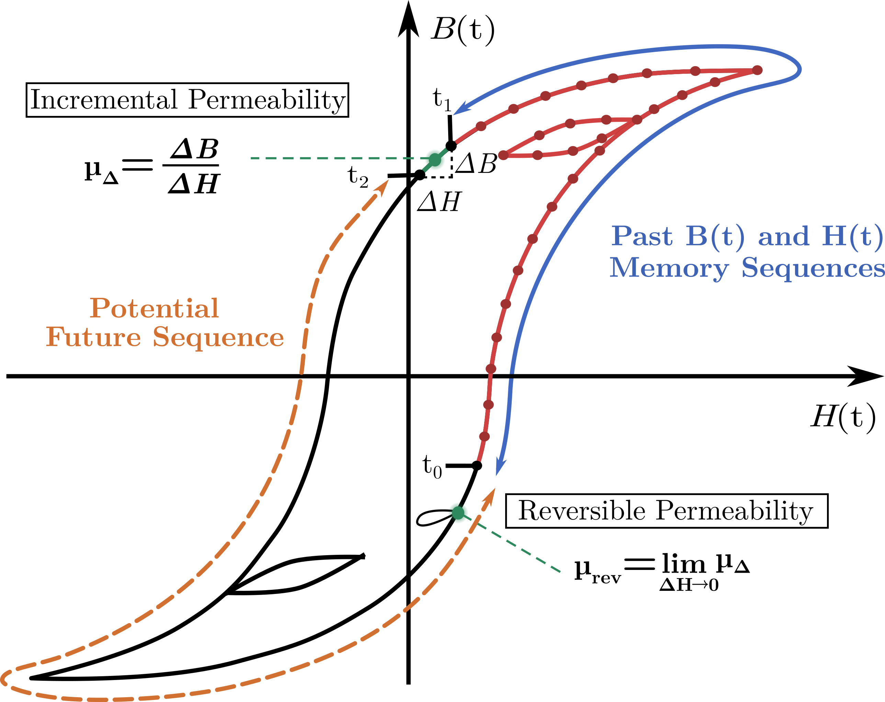
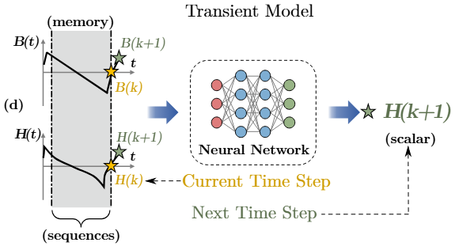
What we have developed (as tutorials)
Input: B(t) in the past 80 steps
H(t) in the past 80 steps
future B(t) from t₁ to t₂
Output: future H(t) from t₁ to t₂
Shukai Wang, Hyukjae Kwon, Haoran Li, et al. ”MagNetX: Foundation Neural Network Models for Simulating Power Magnetics in Transient.” TechRxiv. December 11, 2024. Accepted to APEC 2025.
Notes:
One step, predict autoregressively. Compare it against the magnet challenge 1

Slide 15
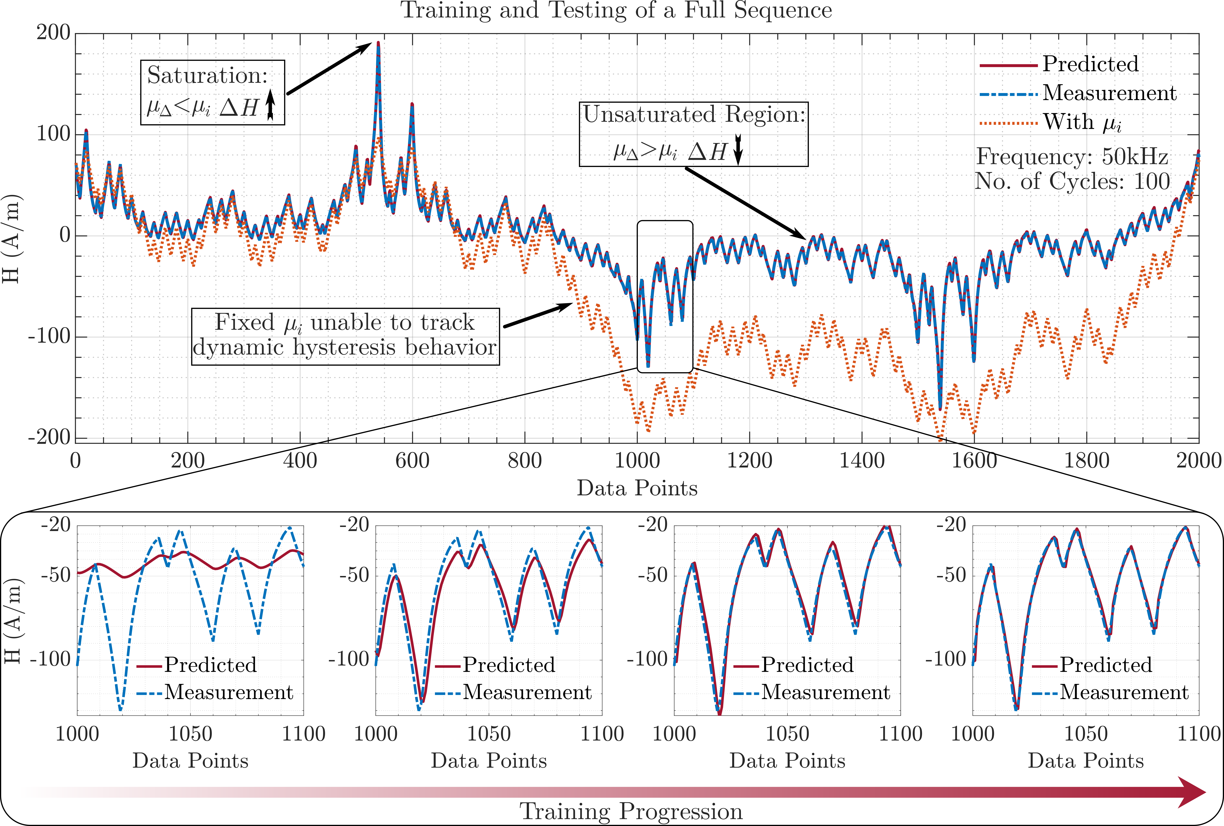
A Large Model for the Long Sequences
Goal: Autoregressive Prediction
Notes:
Accumulation of error, depends on how much past and how much future we are predicting, so expecting variable performance behavior with each model. Red one assuming the perf ideal inductor with ui, and blue is real

Slide 16
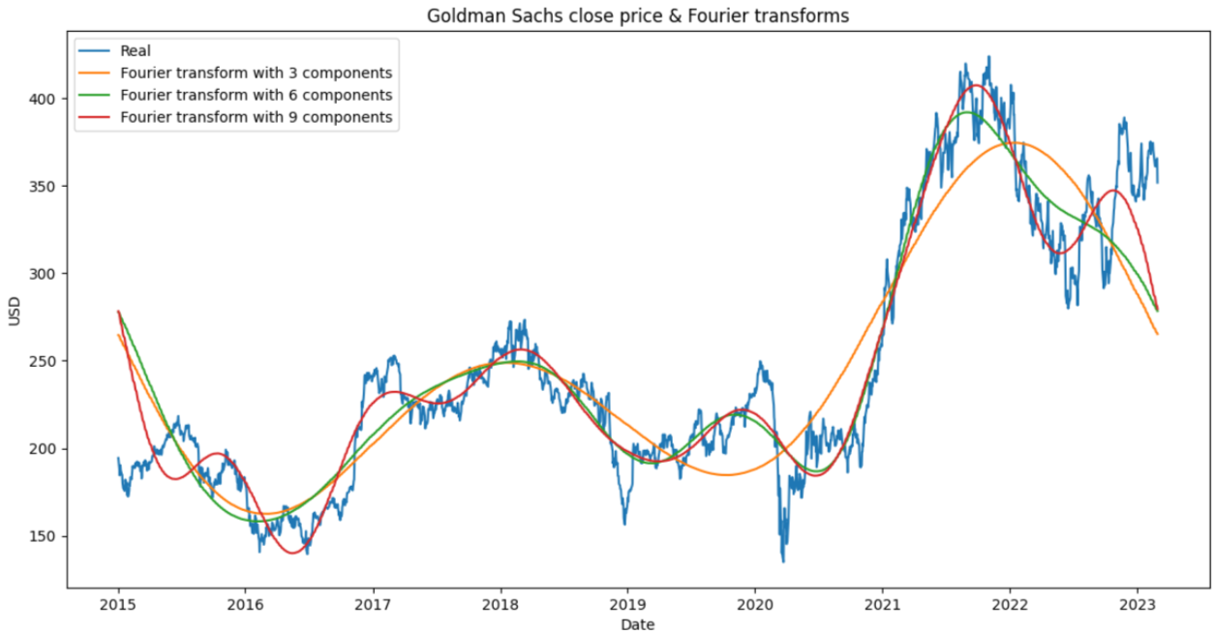
Separate Fast Details and Slow Trends
Time sequence prediction models?
Weather forecasting
Load forecasting
Stock price forecasting
Time domain
Frequency domain
Signal processing
Single-step
Multi-step
Sliding window
…
Notes:
Encourage students to look at multi time domain data, similar to weather forecasting stock price forecasting…

Slide 17
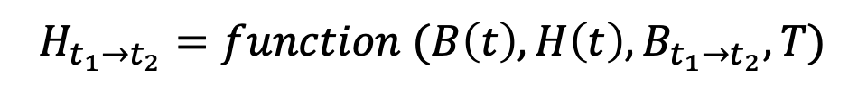
Information Flow of MagNet Challenge 2
Next step:
$$H_{t+1}=function (B\left(t\right), H\left(t\right),B_{t+1}, T)$$
Long cycle:
$$H_{t_{1}→t_{2}}=function (B\left(t\right), H\left(t\right),B_{t_{1}→t_{2}}, T)$$
Large amount of measurement data with B(t), H(t), f, T
Callable Matlab
or Python Function
Equation-based methods
submit
Evaluate the data complexity and select model strategy?
Data-driven methods
Test on data that the model has not seen
submit
Hybrid/other
Model novelty
Model accuracy

Slide 18
Evaluation Criteria
Winning solution: a simple, robust, and trustworthy method to
(1) accurately predict power magnetic behaviors
(2) efficiently use the training data
(3) provide useful design insights
(4) advance understanding about power magnetics
(5) other novel contributions to the field
Model performance: 95th percentile error on RMS error in B-H sequence.
Model size: number of material-specific parameters that need to be kept in the model. Jointly evaluated by submitted package size and code review.
Model novelty: new insights and new methods in physical understanding, data processing, model development, and anything else related to power magnetics.
Model generality: extending the developed model to different materials.
Final Winners selected by the Academic Advisory Committee:
Charles Sullivan, Dartmouth, USA
David Perreault, MIT, USA
SY Ron Hui, CUHK, Hongkong
Jürgen Biela, ETH Zurich, Switzerland
Dragan Maksimovic, UC Boulder, USA

Slide 19
Student Team Eligibility
Eligibility: To confirm eligibility, potential participating schools must submit a Letter of INTENT (attached) by May 1st, 2025, to pelsmagnet@gmail.com, for better coordination.
For each team, the minimum student number is two (2) and the maximum student number is five (5) to qualify for the competition.
We encourage student teams to mix undergraduate and graduate students, and consist at least one (1) faculty advisor and optionally one (1) industry mentor. Interdisciplinary and diversified teams are highly encouraged.
All organizing committee members, except for those from Princeton and Dartmouth, are eligible to participate. There is no conflict of interest.
Note: We will try to host as many teams as possible. We can perhaps host 2-3 teams per university depending on the final total participating team numbers and the quality of the proposals.
Members of the judging committee will be replaced if there is a conflict from the same university. Student teams will NOT be judged by experts with conflicts of interest.
We will invite 20-30 prominent researchers from academia and industry as scientific advisors to student teams.

Slide 20
Timeline of the MagNet Challenge 2
Feb 13st, 2025 | Initial Call for Participation Announcement
Feb 26th, 2025 | MagNet Challenge 2 Information Session
March 18th, 2025 | APEC Official Announcement
April 1st, 2025 | Online Q&A Session
May 1st, 2025 | 1-Page Letter of Intent Due with Signature [Attached]
June 1st, 2025 | 2-Page Proposal Due for Eligibility Check [TPEL Format]
July 1st, 2025 | Notification of Acceptance [Eligibility Check]
Nov 1st, 2025 | Preliminary Submission Due, Finalists Selected
Dec 24th, 2025 | Final Submission Due
March 1st, 2026 | Winner Announcement and Presentation
April 1st - Large amount of data for 10 materials released
MagNet Methodology
Develop methods on old materials
Test methods on new materials
Train models with small datasets
Test models with large datasets
May 1st – 1-Page letter of intent due
Nov 1st – Release small training data for 5 new materials
June 1st – 2-Page proposal due
July 1st – All participating teams confirmed
Dec 24th – Callable models and predicted core loss (P_{v}) for 10+5 materials under a variety of {B(t), f, T} conditions, and a 5-page TPEL format report due
March 1st , 2026 – Winner Announcement
Notes:
Nov 1st big amount for training, small for testing for 5 new materials. Perhaps a separate slide to sperate the detailed version

Slide 21
Award Structure (TBD)
Award for Model Performance 1st Place $10,000 | Award for Model Novelty 1st Place $10,000 | Award for Outstanding Software Engineering $5,000
Award for Model Performance 2nd Place $5,000 | Award for Model Novelty 2nd Place $5,000 | Honorable Mentions $1,000 x multiple
Performance
Model size
Novelty
Model generality
Software implementation
Other contributions
Intellectual Property
MagNet Challenge 2 has no restrictions on intellectual property.
We encourage open-source culture and open-source licenses.
Presenting the models to MagNet team is considered as public disclosure.
Student teams should take actions before disclosure if IP protection is needed.

Slide 22
Extended Reading – MagNet Challenge 2
J-A Model – D. Jiles and D. Atherton, “Theory of ferromagnetic hysteresis,” Journal of Magnetism and Magnetic Materials, vol. 61, no. 1, pp. 48–60, 1986.
Preisach Model – F. Preisach, “Uber die magnetische Nachwirkung,” Zeitschrift fur Physik,vol. 94, no. 5-6, pp. 277–302, May 1935.
LLG Model – H. H. Cui, S. Dulal, S. B. Sohid, G. Gu, and L. M. Tolbert, “Unveilingthe microworld inside magnetic materials via circuit models,” IEEEPower Electronics Magazine, vol. 10, no. 3, pp. 14–22, 2023.
iGSE-PFC – M. J. Jacoboski, A. de Bastiani Lange and M. L. Heldwein, “Closed-Form Solution for Core Loss Calculation in Single-Phase Bridgeless PFC Rectifiers Based on the iGSE Method,” in IEEE Transactions on Power Electronics, vol. 33, no. 6, pp. 4599-4604, June 2018.
Why MagNet – D. Serrano et al., “Why MagNet: Quantifying the Complexity of Modeling Power Magnetic Material Characteristics,” in IEEE Transactions on Power Electronics, vol. 38, no. 11, pp. 14292-14316, Nov. 2023.
How MagNet – H. Li et al., “How MagNet: Machine Learning Framework for Modeling Power Magnetic Material Characteristics,” in IEEE Transactions on Power Electronics, vol. 38, no. 12, pp. 15829-15853, Dec. 2023.
MagNet-AI – H. Li, D. Serrano, S. Wang and M. Chen, “MagNet-AI: Neural Network as Datasheet for Magnetics Modeling and Material Recommendation,” in IEEE Transactions on Power Electronics, vol. 38, no. 12, pp. 15854-15869, Dec. 2023.
MagNet Challenge – M. Chen et al., “MagNet Challenge for Data-Driven Power Magnetics Modeling,” in IEEE Open Journal of Power Electronics, accepted.

Slide 23
Extended Reading – MagNet Challenge 2
iGSE - K. Venkatachalam, C. R. Sullivan, T. Abdallah and H. Tacca, “Accurate prediction of ferrite core loss with nonsinusoidal waveforms using only Steinmetz parameters,” Proc. IEEE Workshop Comput. Power Electron., pp. 36-41, 2002.
iGSE - Matlab Implementation https://www.mathworks.com/matlabcentral/fileexchange/39995-magnetic-core-loss-evaluation-for-arbitrary-flux-waveforms
i2GSE - J. Muhlethaler, J. Biela, J. W. Kolar and A. Ecklebe, “Improved Core-Loss Calculation for Magnetic Components Employed in Power Electronic Systems,” in IEEE Transactions on Power Electronics, vol. 27, no. 2, pp. 964-973, Feb. 2012.
iGSE-CD - D. Menzi et al., “iGSE-CD—An Electric-/Displacement-Field Related Steinmetz Model for Class II Multilayer Ceramic Capacitors Under Low-Frequency Large-Signal Excitation,” in IEEE Open Journal of Power Electronics, vol. 4, pp. 107-116, 2023.
Stenglein Model - E. Stenglein and T. Dürbaum, “Core Loss Model for Arbitrary Excitations With DC Bias Covering a Wide Frequency Range,” in IEEE Trans. on Magnetics, vol. 57, no. 6, pp. 1-10, June 2021.
IGCC - T. Guillod, J. S. Lee, H. Li, S. Wang, M. Chen, C. R. Sullivan, “Calculation of Ferrite Core Losses with Arbitrary Waveforms Using the Composite Waveform Hypothesis,” IEEE Applied Power Electronics Conference (APEC), 2023.
MagNetX Models - S. Wang, H. Kwon, H. Li, et al. “MagNetX: Foundation Neural Network Models for Simulating Power Magnetics in Transient,” TechRxiv. December 11, 2024.
MagNetX Database - H. Kwon, S. Wang, H. Li, et al. “MagNetX: Extending the MagNet Database for Modeling Power Magnetics in Transient,” TechRxiv. December 11, 2024.

